Slide 1
Social Media Assistance Packet
National School Breakfast Week
This Social Media Assistance Packet provides schools with social media posts (images and text) to make is easy to share your National School Breakfast Week celebrations and increase student engagement! Use the best practices below, along with the copy-and-paste images and posts, to spread awareness on the importance of the program in providing nutritious meals and encourage student participation!
Social Media Best Practices
Developing your social media strategy in advance can eliminate stress and ensure consistent messaging. Keep in mind these best practices while planning content, whether it’s for your school’s website Facebook, X (formerly Twitter) or Instagram.
Your Audience includes parents/caregivers, children, local media, and community leaders. Language and content should be tailored to reach your intended audience. Always keep the reader in mind as you write. Every message should be easy for your audience to read.
Use Photos, Videos or GIFs to add visual appeal and capture attention. Use the images we provided or add your own!
Live Feeds, Reels, and Stories offer ways to add interactive elements and further engage your audience.
A Social Media Tag creates a short link to a profile and the post may be added to that person’s or group’s timeline. This makes your posts easier to find! This can also help reach media and local officials. Consider tagging local news outlets, radio stations, and your local mayor.
Tag TDA on Social Media!
X (formerly Twitter): @TexasDeptofAg
Facebook: TexasDepartmentofAgriculture
Instagram: @texasagriculture
Hashtags: #TXSBW #NSBW24
This product was funded by USDA.
This institution is an equal opportunity provider.
Updated 10/20/2022 www.SquareMeals.org

Slide 2
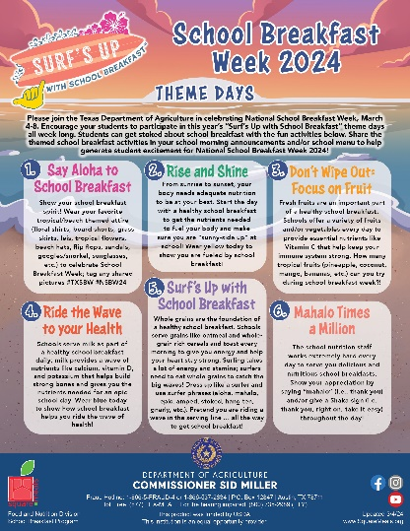
Copy-and-Paste
Images and Posts
POST #1
Get stoked for National School Breakfast Week! Join us March 4-8 as we celebrate with the theme “Surf’s Up with School Breakfast.” Check out our theme days and encourage your students to eat breakfast at school! #TXSBW #NSBW
POST #2
Surf’s Up with School Breakfast - This week, March 4-8, is National School Breakfast Week! Get your students amped and encourage them to eat an epic breakfast at school! #TXSBW #NSBW
POST #3
Cowabunga! School breakfast has the nutrients and energy students need to “ride the wave” to academic success! Check out our celebration menu for March 4-8 and encourage your students to eat with us! #TXSBW #NSBW
This product was funded by USDA.
This institution is an equal opportunity provider.
Updated 10/20/2022 www.SquareMeals.org

Slide 3
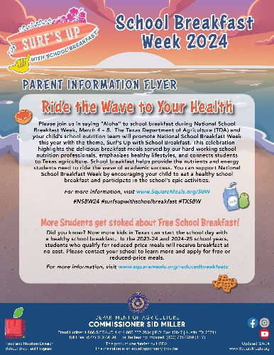
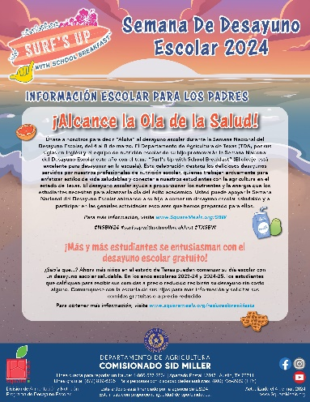
Copy-and-Paste
Images and Posts
POST #4
Don’t Wipe Out – remember to join us for breakfast as we celebrate National School Breakfast Week! Be sure to say “Mahalo” to the school nutrition professionals at your school to show appreciation for their hard work in providing students with nutritious school meals! #TXSBW #NSBW
POST #5
Aloha Parents! Check out our flyer to learn how you can get involved in National School Breakfast Week, March 4-8! Visit www.SquareMeals.org/SBW for more information. #TXSBW #NSBW
POST #6
Thank you for joining us during National School Breakfast Week (SBW) 2024! Check out our students having an epic time celebrating school breakfast! We look forward to NSBW 2025 - Mahalo! #TXSBW #NSBW
This product was funded by USDA.
This institution is an equal opportunity provider.
Updated 10/20/2022 www.SquareMeals.org

